Slide 1




Building an Engaging Gym Landing Page
Learn how to create a captivating gym landing page using HTML, CSS, and JavaScript. Explore the login and sign-in process and the implementation of buttons for enhanced user experience.
by Arpit Patel

Slide 2

Introduction
Discover the purpose and design of the gym landing page, and how it can attract and engage visitors. Let's dive into the project's details.

Slide 3

Design and Layout
HTML & CSS
Layout & Visual Elements
Get an overview of the HTML and CSS techniques used in the gym landing page to create a visually appealing design.
Explore the layout and visual elements of the gym landing page, including fonts, colors, and images.

Slide 4
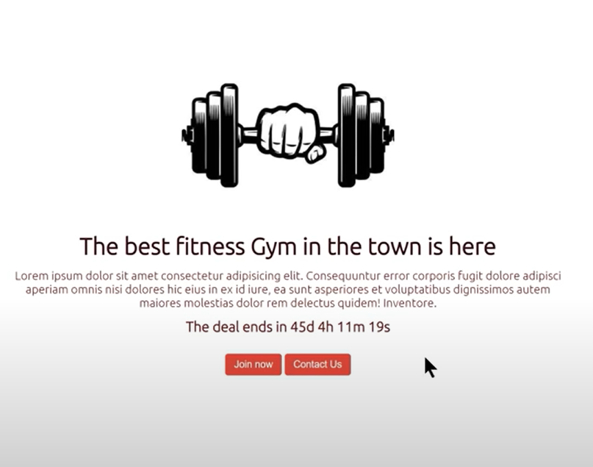

Slide 5
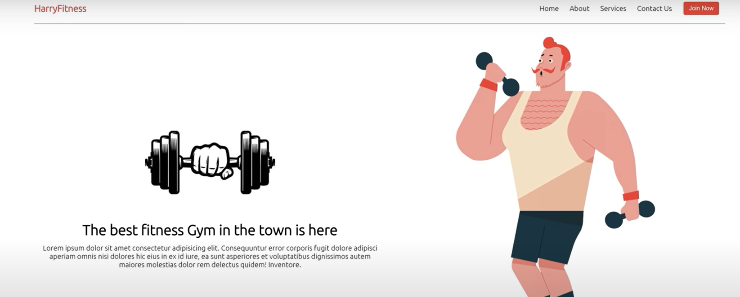

Slide 6
Functionality
JavaScript Implementation
Login & Sign-In Process
Understand how JavaScript enhances the functionality of the gym landing page and improves user interaction.
Learn how the login and sign-in process is integrated into the gym landing page for a seamless user experience.

Slide 7

Use of States
1
Enhancing User Experience
Discover how states are used in the gym landing page to provide real-time feedback and improve user engagement.

Slide 8
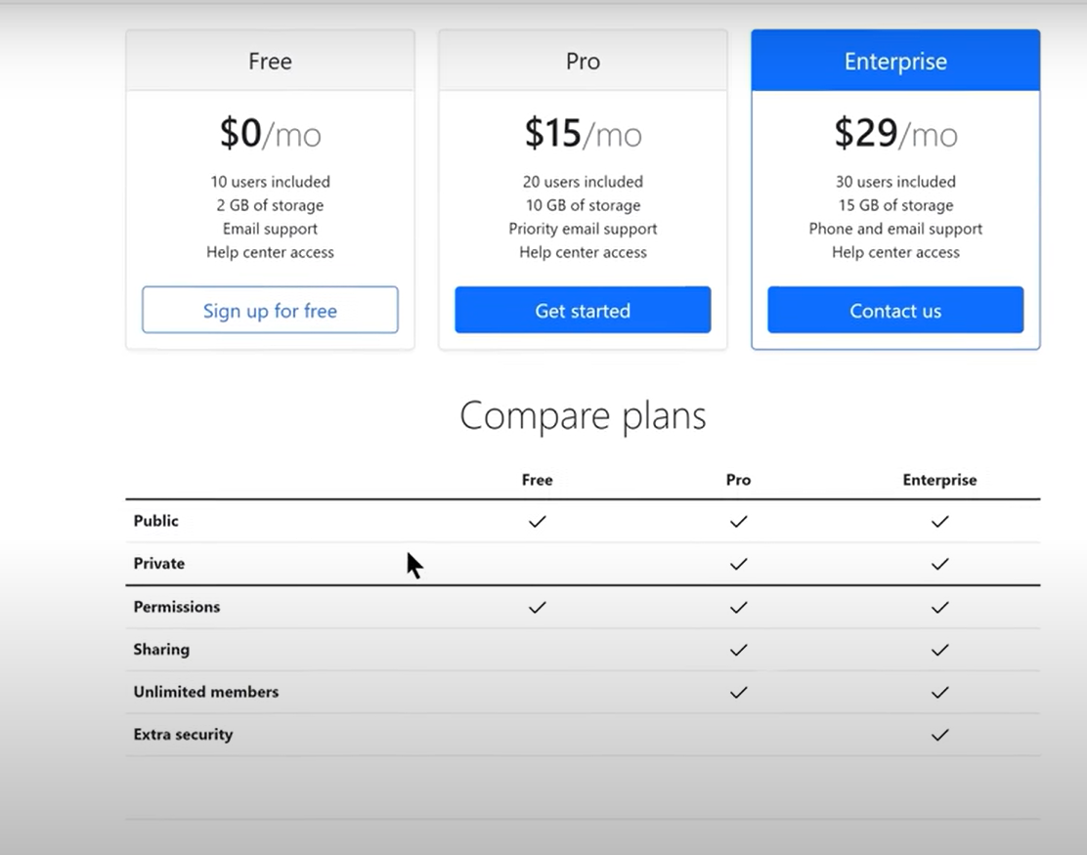

Slide 9
Button Implementation
Types & Purposes
Integration into Web Page
Explore the various types and purposes of buttons used on the gym landing page to drive user interaction and achieve specific goals.
Learn how buttons are seamlessly integrated into the gym landing page, creating a cohesive and intuitive user interface.

Slide 10

Conclusion
Recap the gym landing page project and its objectives. Reflect on the design choices and functionality implemented, highlighting the success of the final product.

